Slide 1
Machine Learning for Predicting Hospital Readmission
Yung Chou
12/12/2018

Slide 2
Agenda
Motivation
Data Set
Data Preparation
Machine Learning Model
Results
Lessons Learned

Slide 3
Motivation
Personal interests
Relevance
Indication to health care quality and a patient’s experience
Interpretation and implementation
Public health
Hospital Readmissions Reduction Program (HRRP)
Center for Medicare & Medicaid Services (CMS)
An important and on-going topic
Long-term health care quality and cost-effectiveness

Slide 4
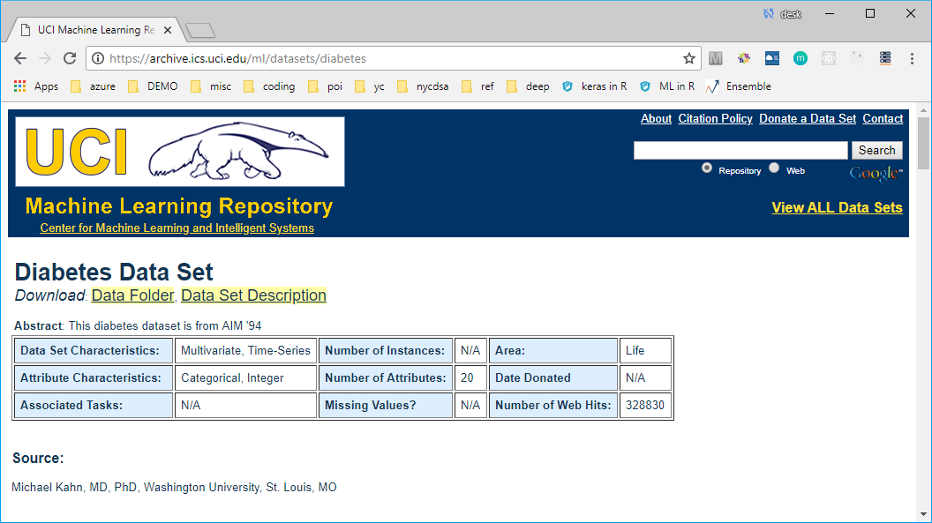
Data Set

Slide 5
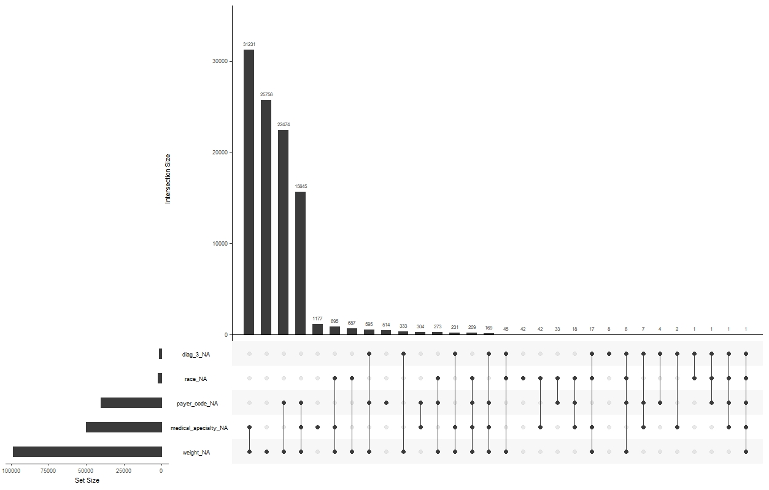
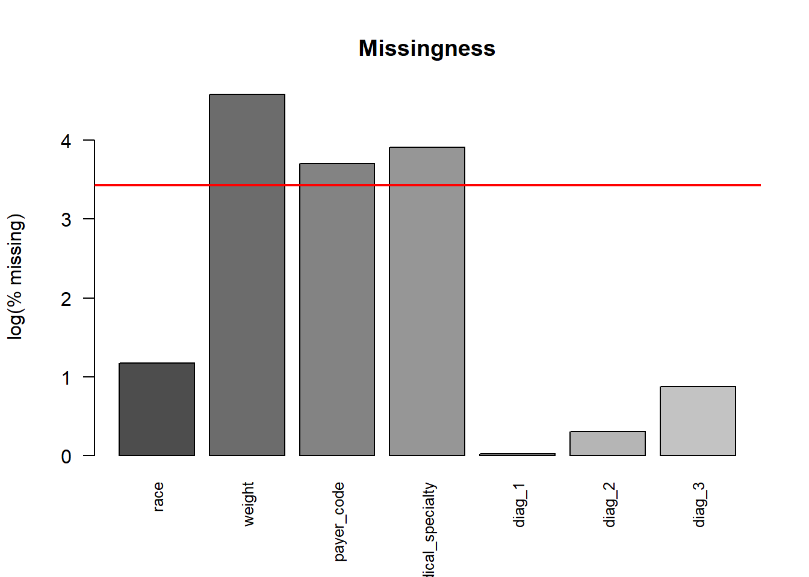
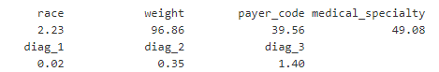
Missingness
Percentage of missing values

Slide 6
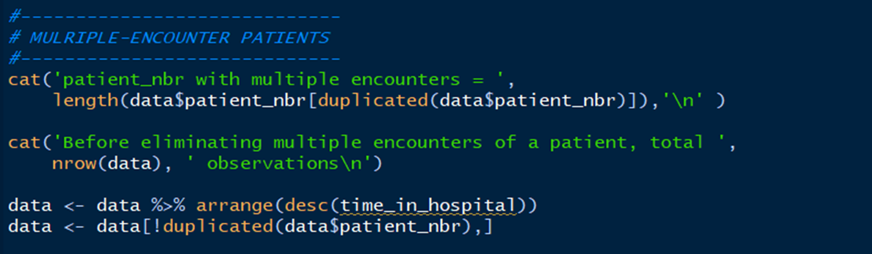
Near zero-variance variables
Multiple-encounter patients

Slide 7
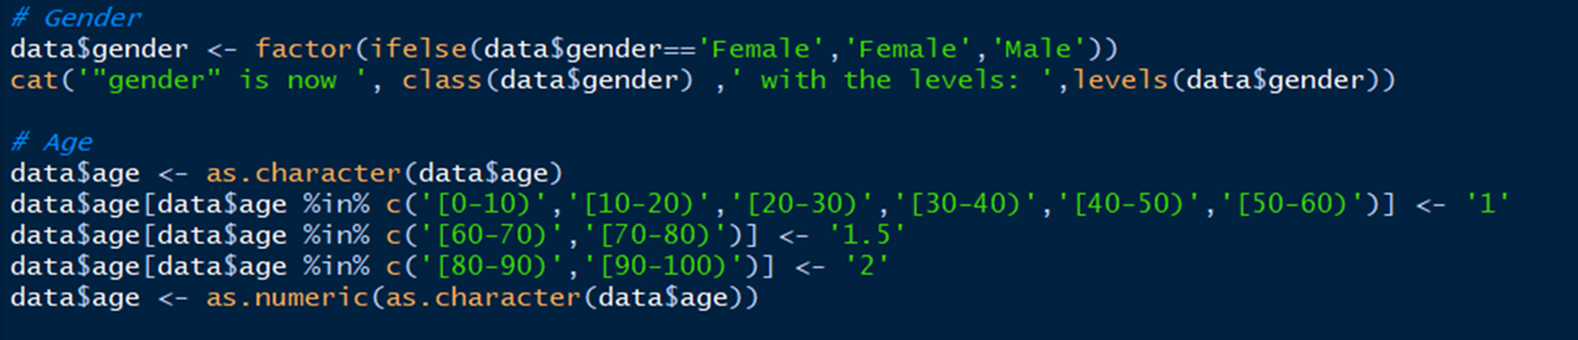
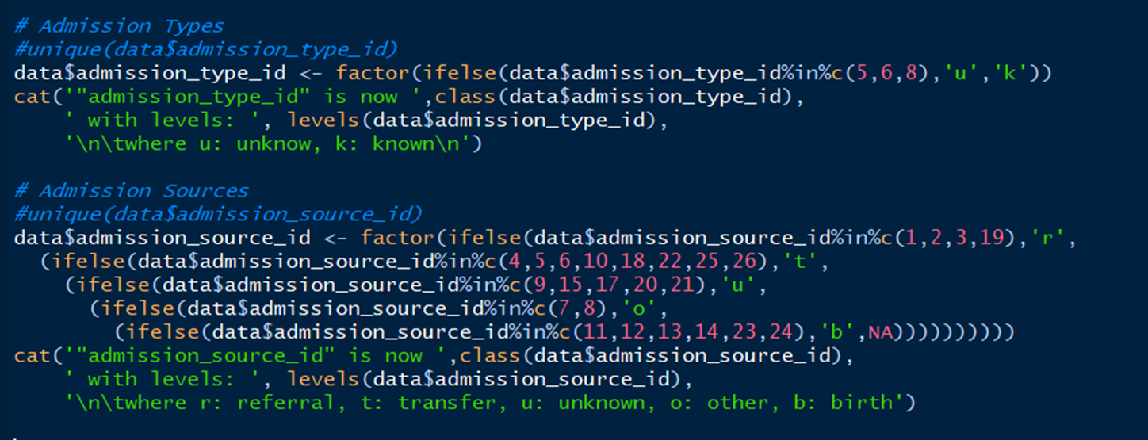

Slide 8
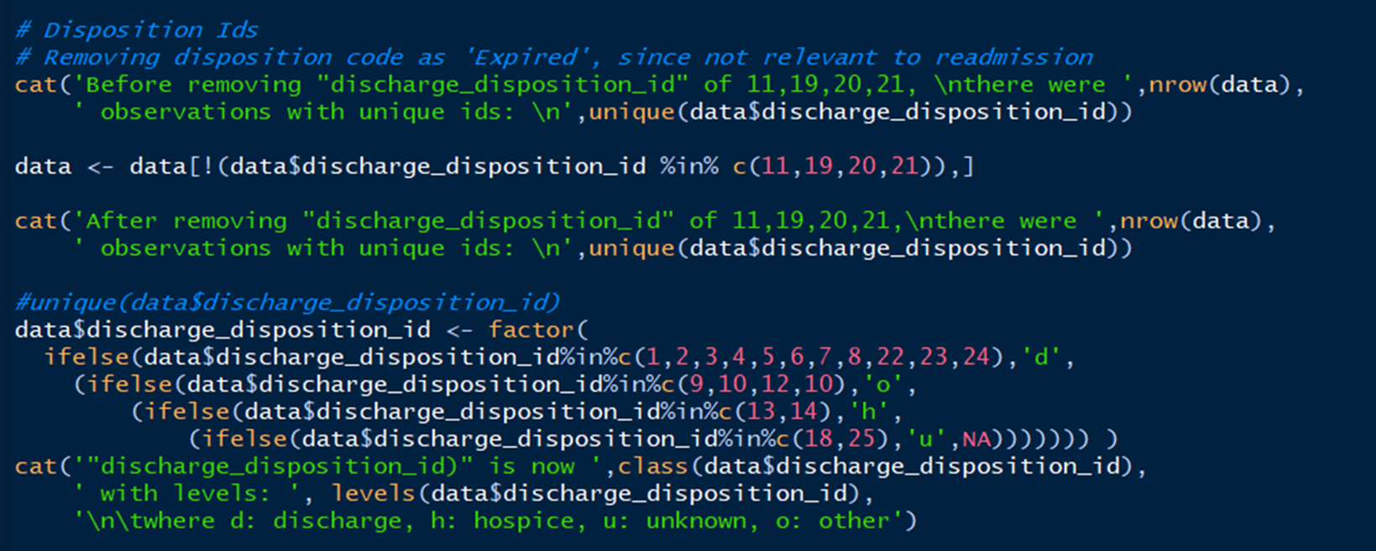

Slide 9
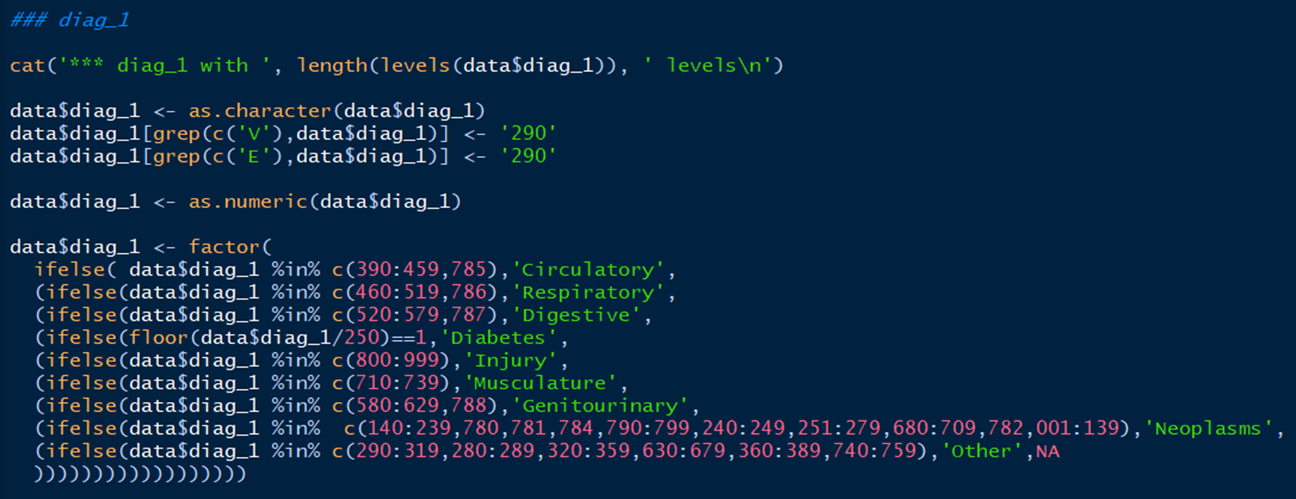
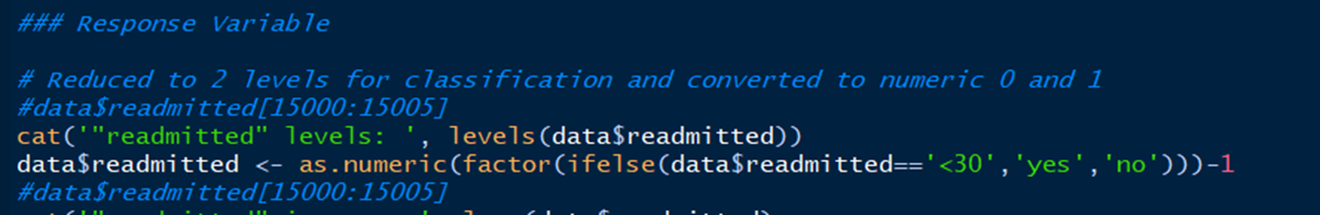

Slide 10
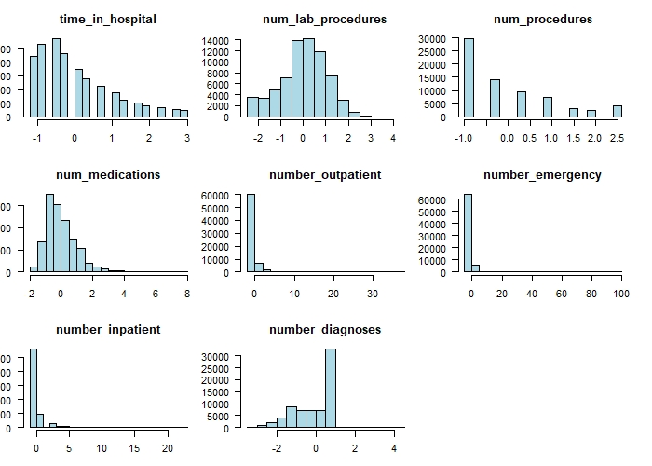
Numeric variables

Slide 11
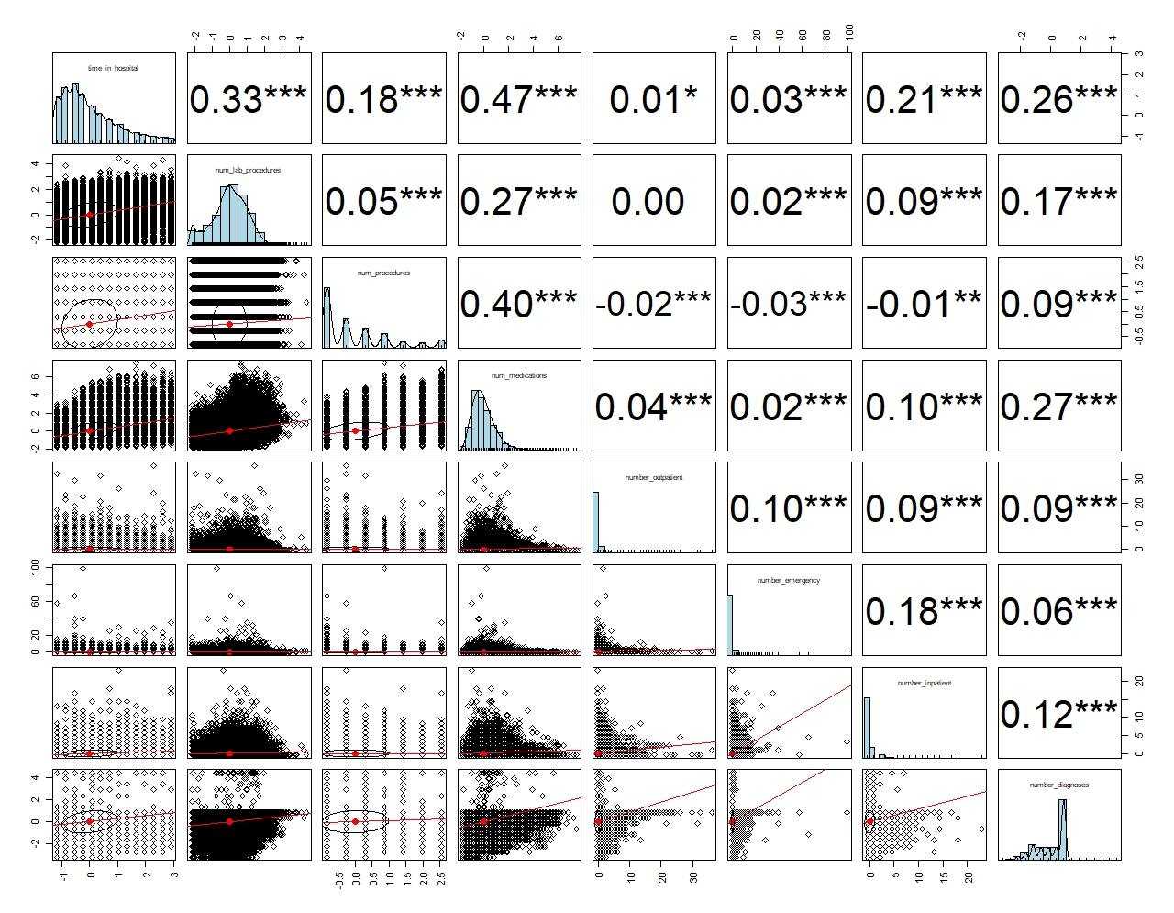

Slide 12
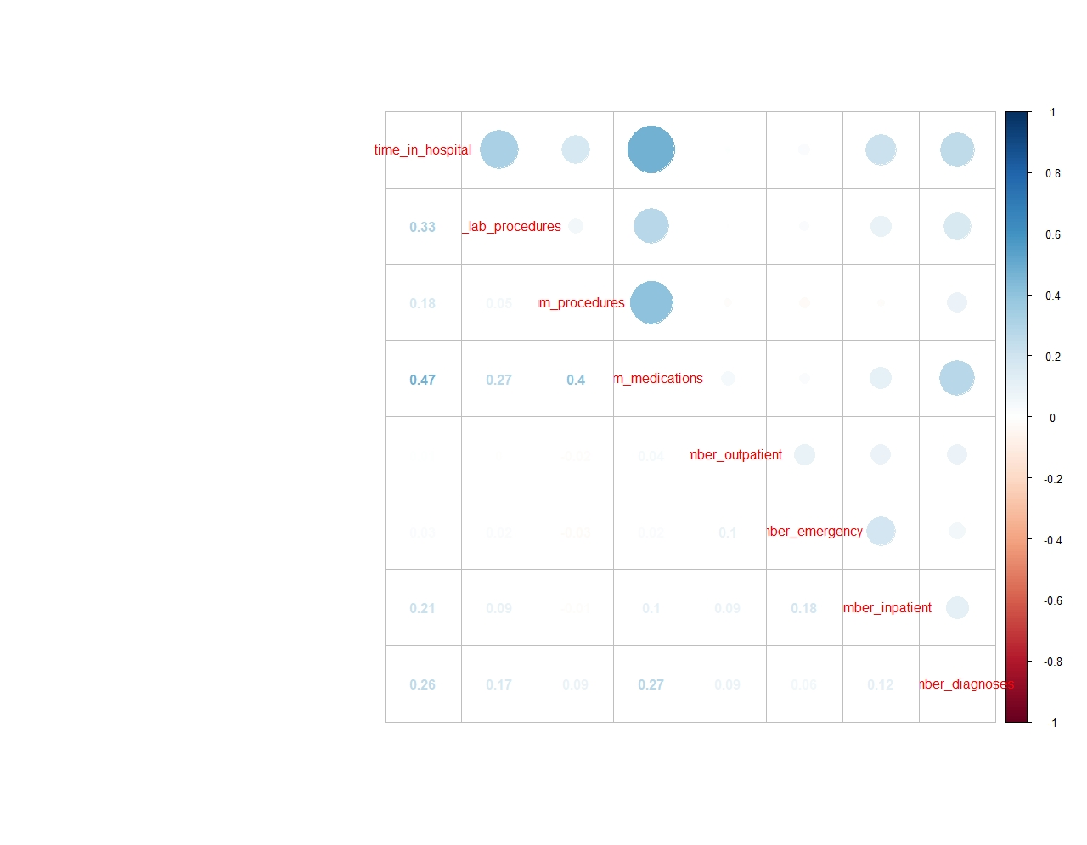

Slide 13
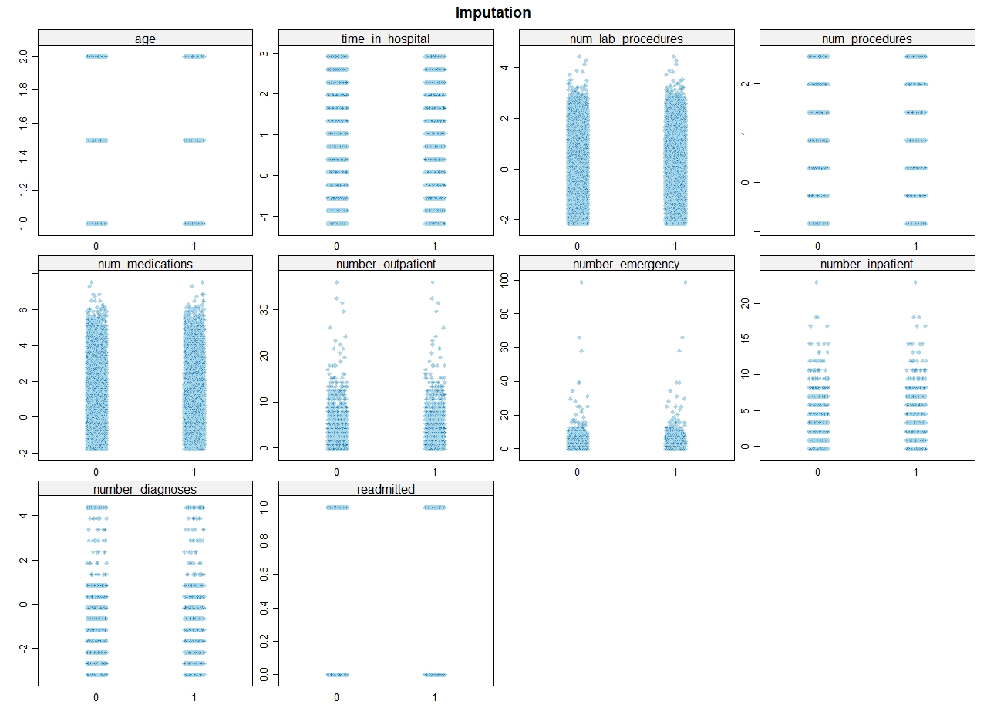

Slide 14
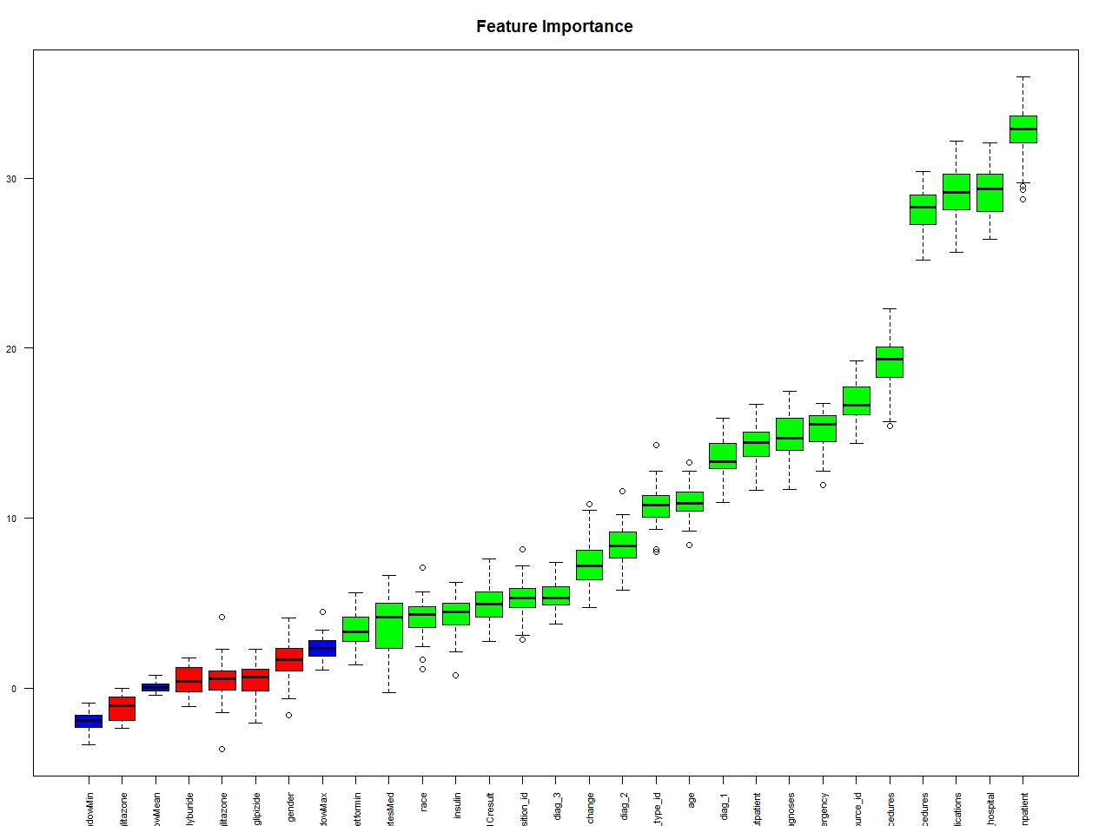
Boruta selected features
"race“
"age“
"admission_type_id" "discharge_disposition_id" "admission_source_id" "time_in_hospital"
"num_lab_procedures" "num_procedures" "num_medications"
"number_outpatient" "number_emergency" "number_inpatient"
"diag_1“
"diag_2“
"diag_3"
"number_diagnoses"
"A1Cresult“
"metformin"
"insulin“
"change“
"diabetesMed"

Slide 15
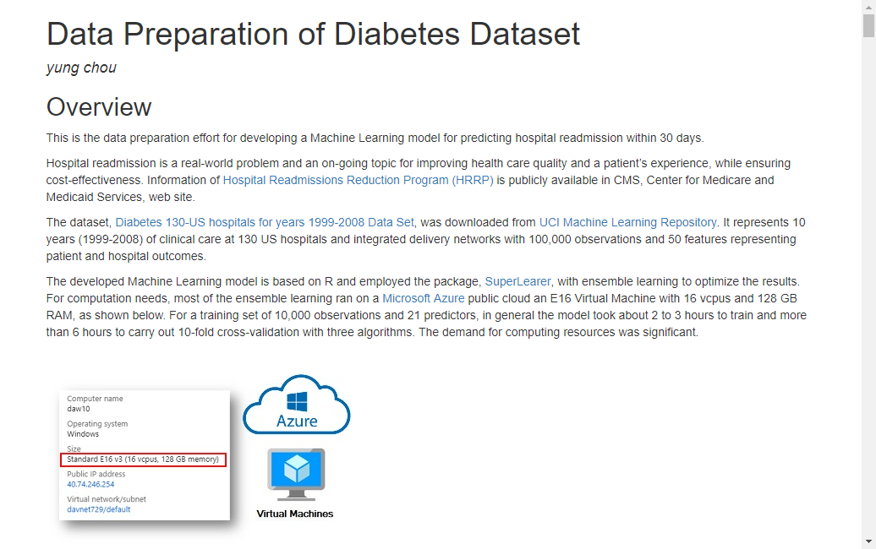
http://yungchou.github.io/site

Slide 16


Slide 17

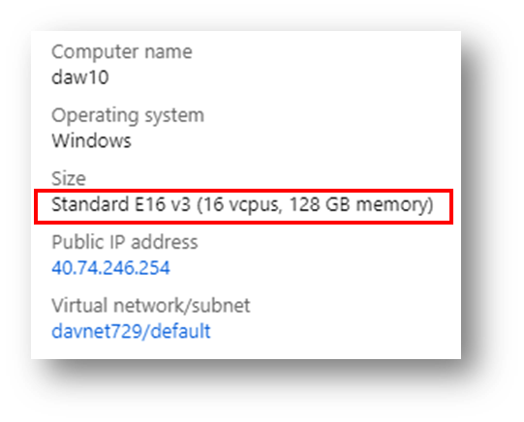

Machine Learning
SuperLearner
Various algorithms
Ensemble models

Slide 18
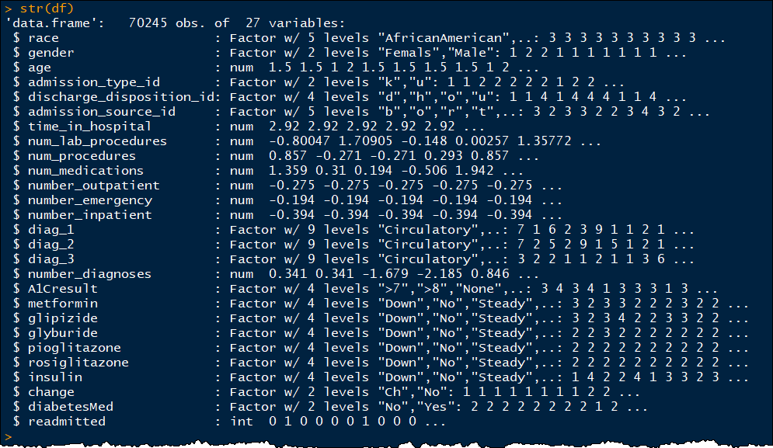

Slide 19
RandomForest
when you are down and out

Slide 20
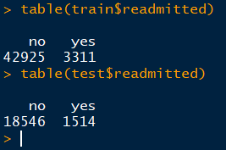
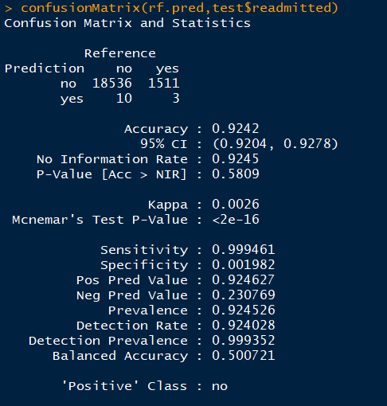
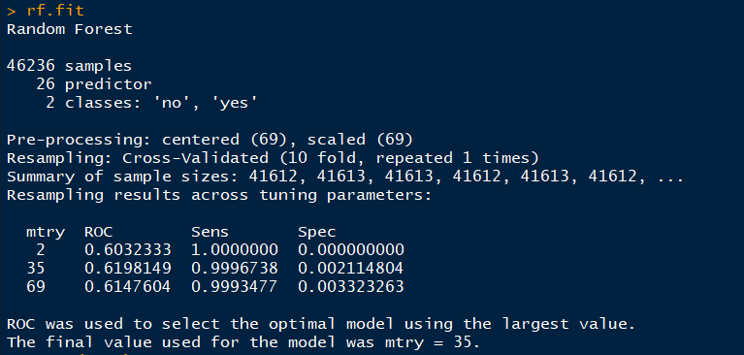
66K, 70/30 split
There must be a message…

Slide 21

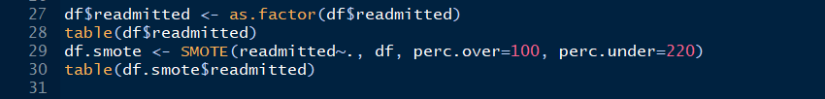
SMOTE
Highly unbalanced data
SMOTE (Chawla et. al. 2002)
To artificially generate new examples of the minority class
The majority class examples also under-sampled, leading to a more balanced dataset

Slide 22
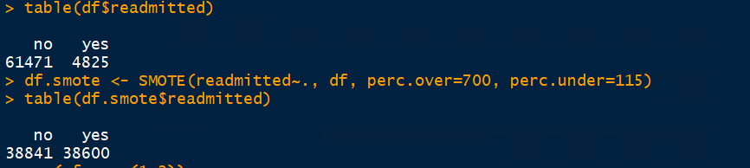
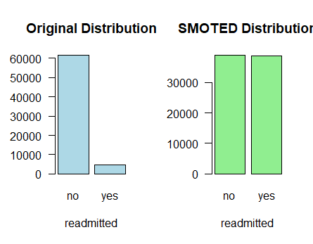

Slide 23
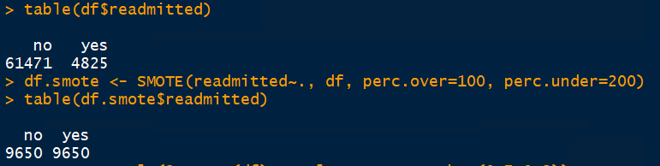
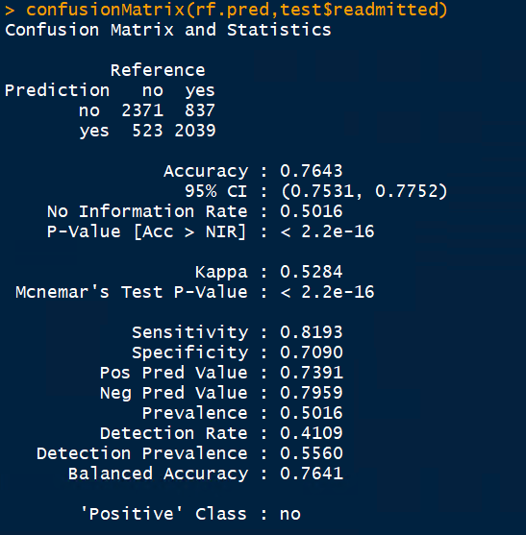
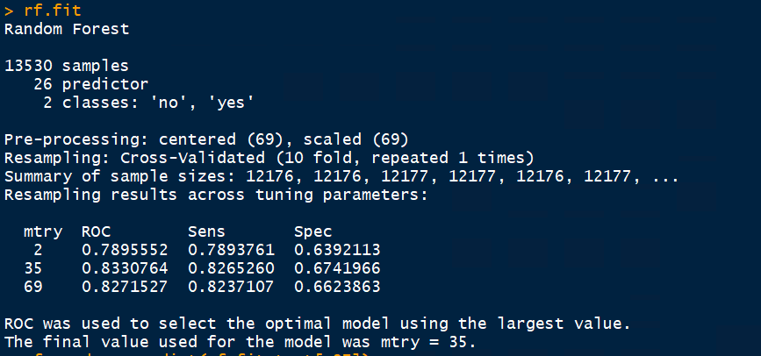
smote data
method = ‘rf’
10-fold cv

Slide 24
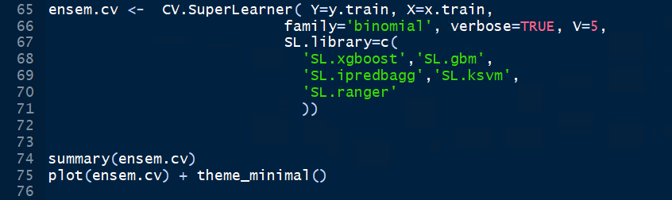
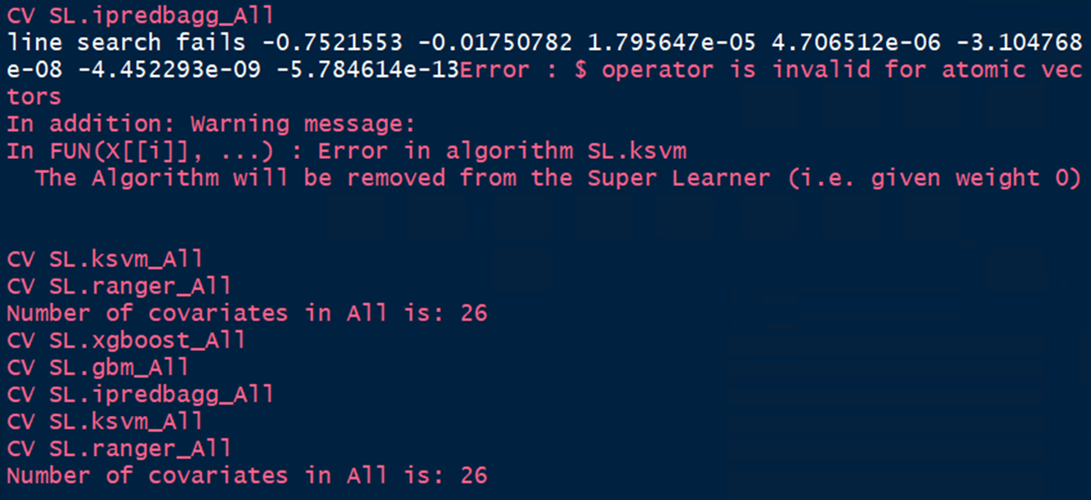
Ensemble Learning

Slide 25
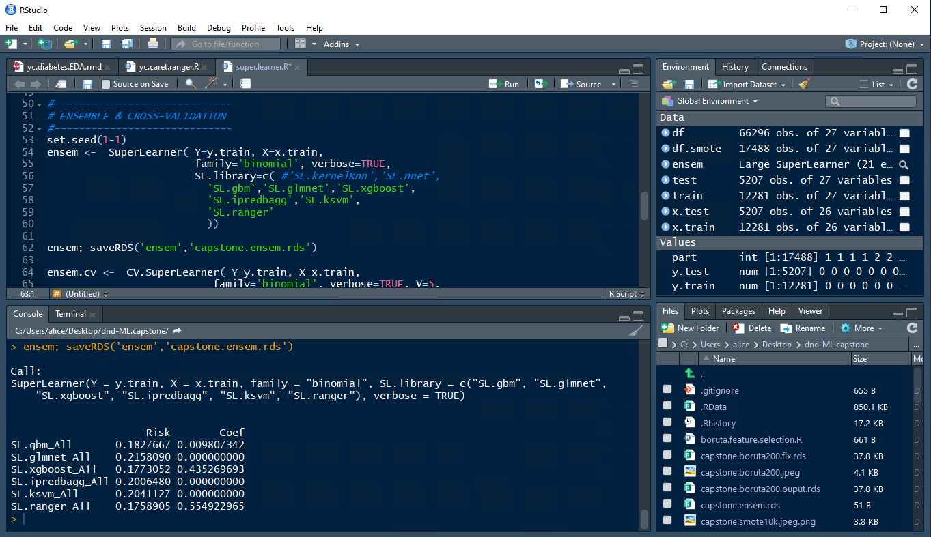

Slide 26
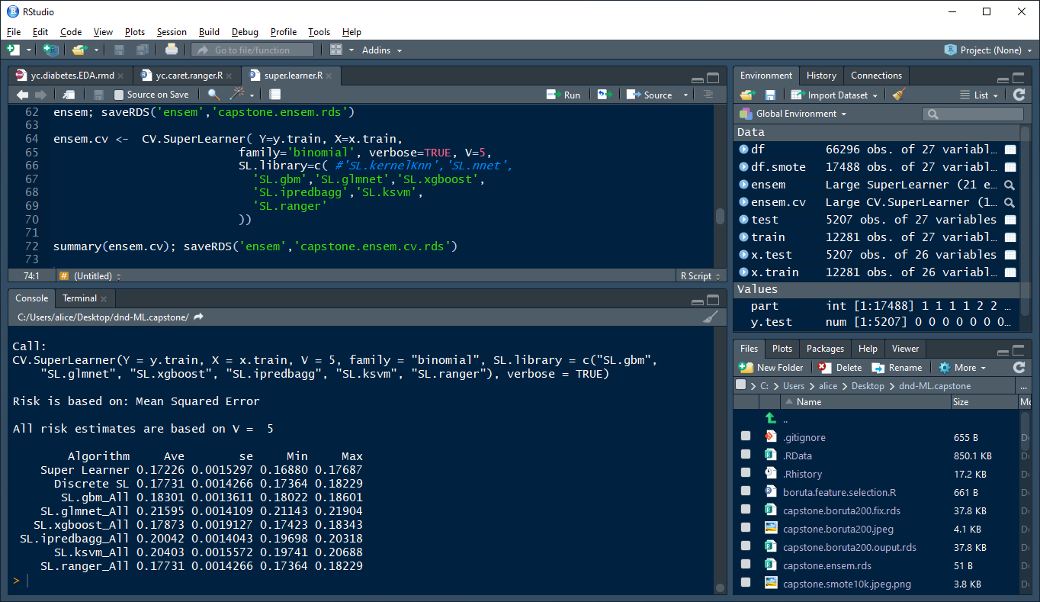

Slide 27
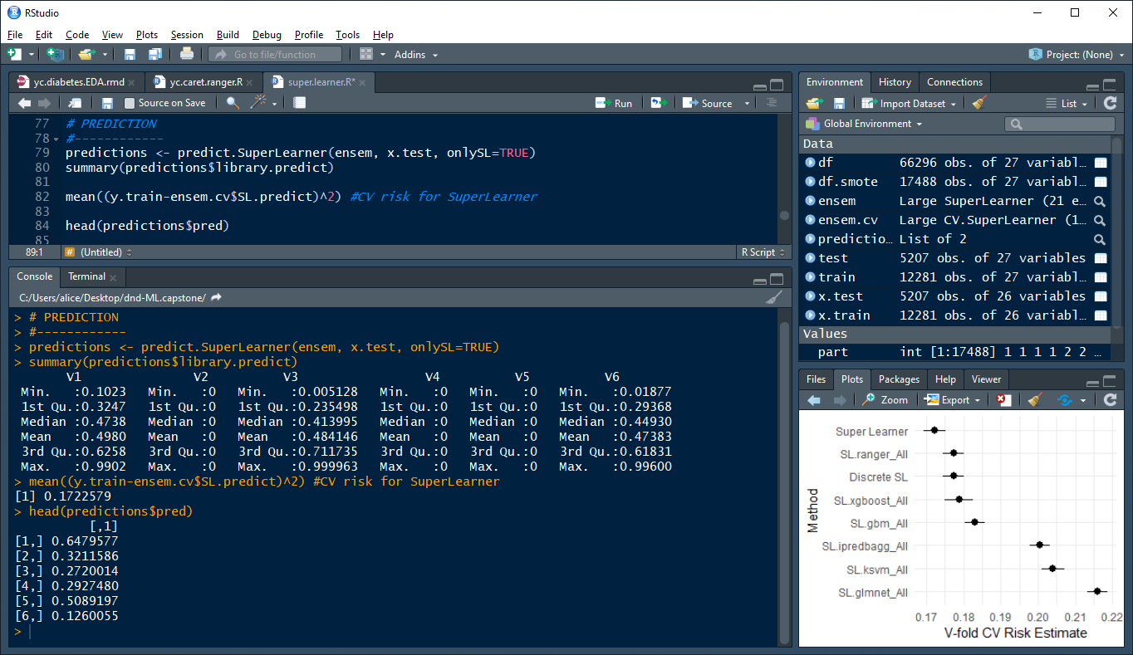

Slide 28
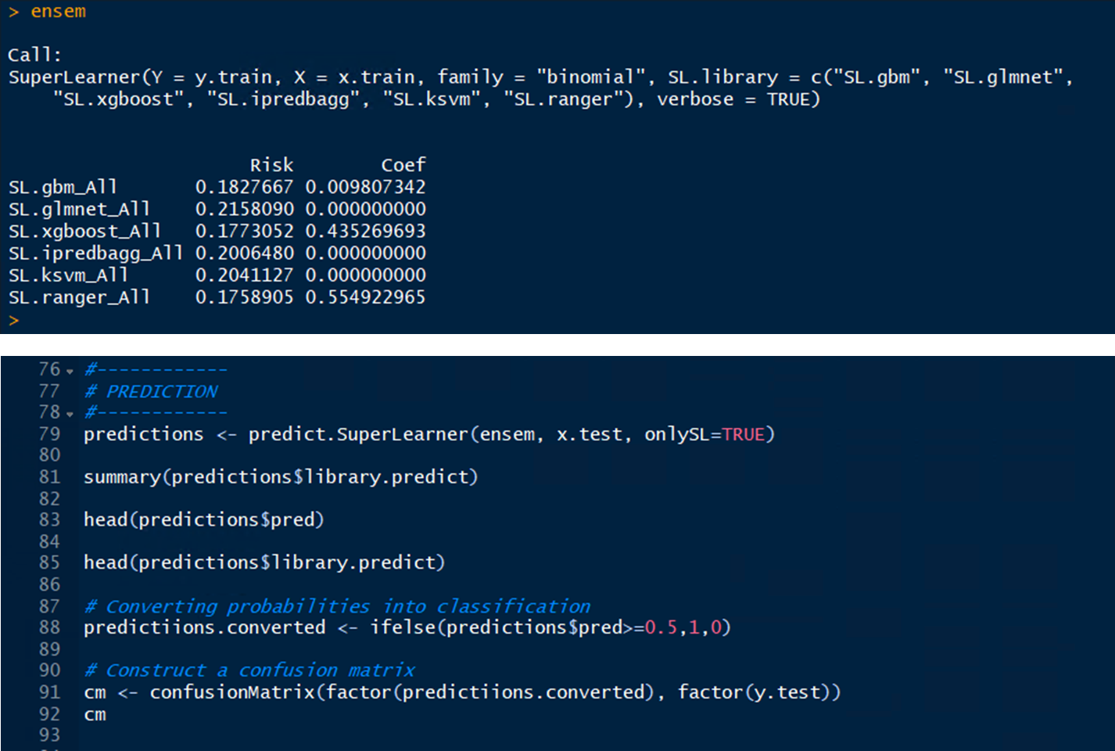

Slide 29
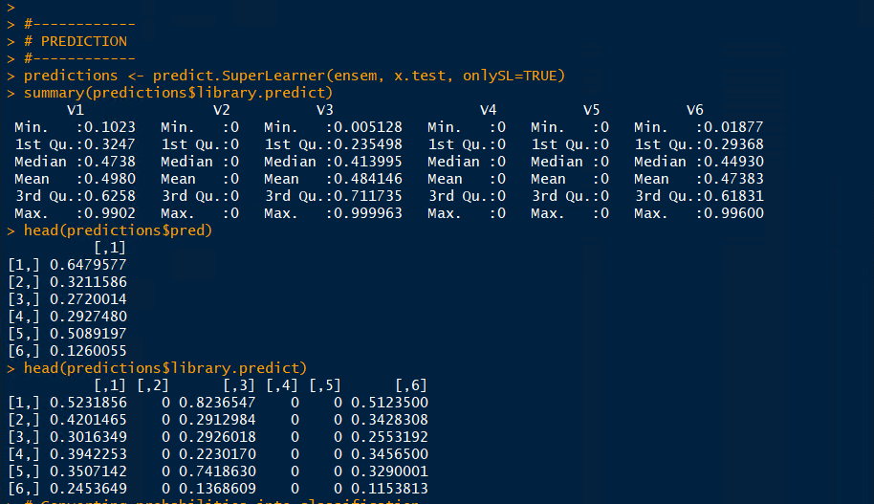

Slide 30
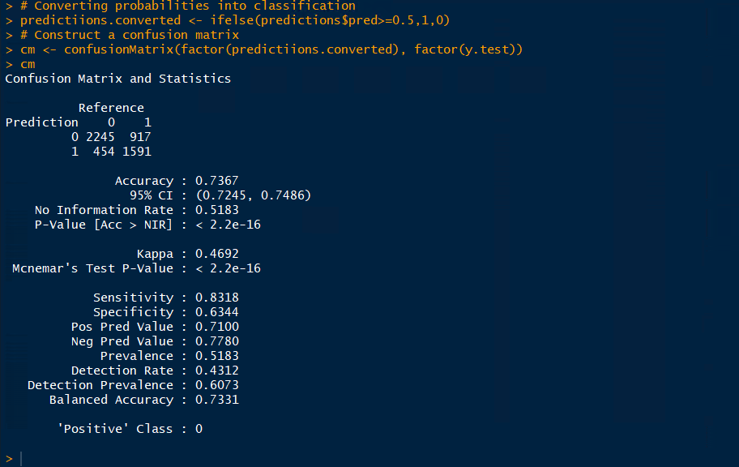
5K, 70/30 split

Slide 31
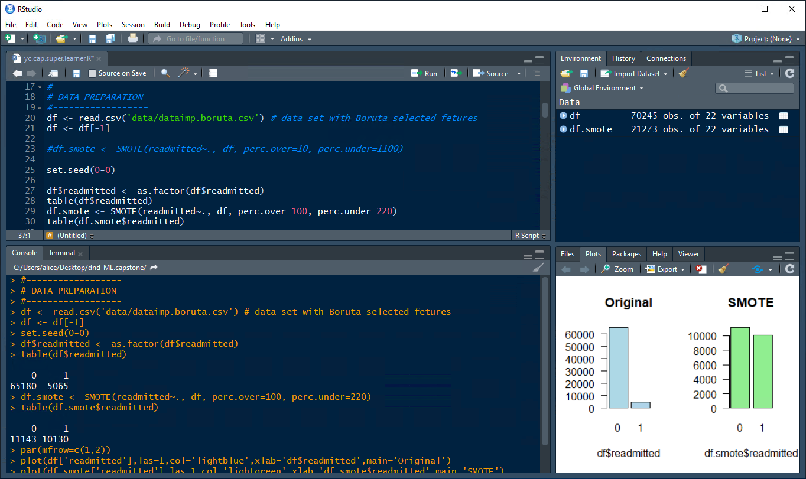
Increased samples 4 times to 20K

Slide 32
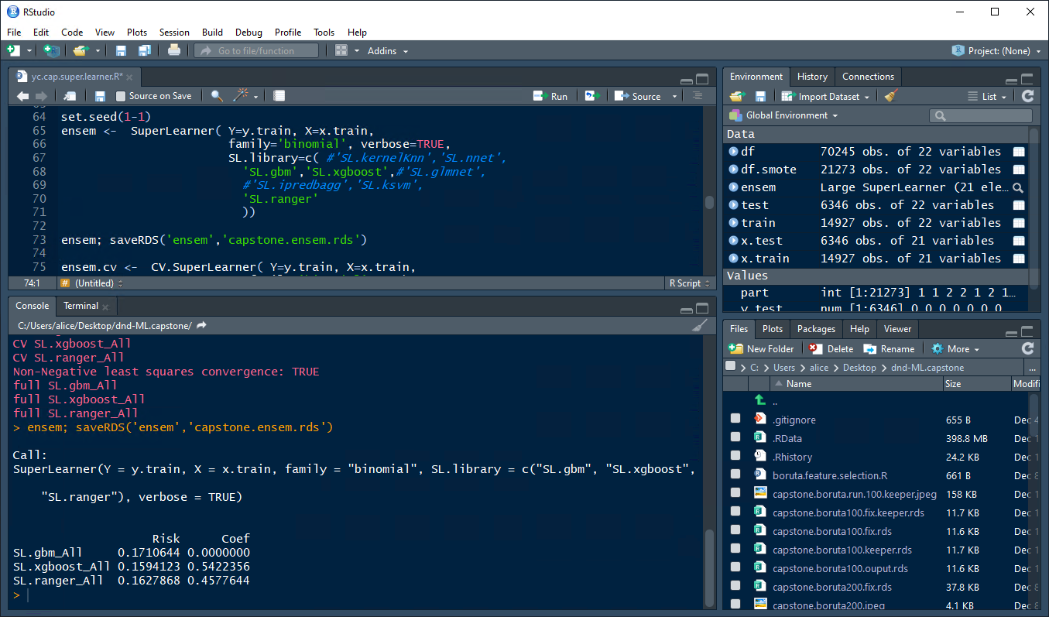
Dropped
ipredbagg, skm, glmnet

Slide 33
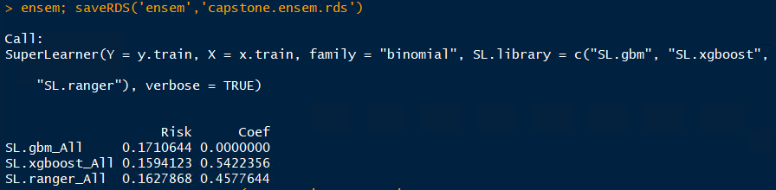
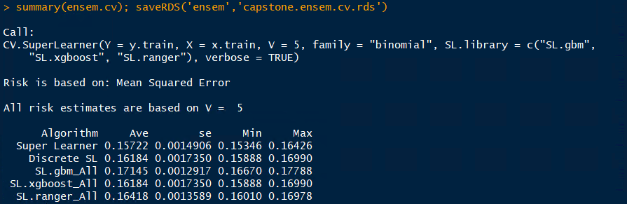
Notes:
> ensem; saveRDS('ensem','capstone.ensem.rds')
Call:
SuperLearner(Y = y.train, X = x.train, family = "binomial", SL.library = c("SL.gbm", "SL.xgboost",
"SL.ranger"), verbose = TRUE)
Risk Coef
SL.gbm_All 0.1710644 0.0000000
SL.xgboost_All 0.1594123 0.5422356
SL.ranger_All 0.1627868 0.4577644

Slide 34
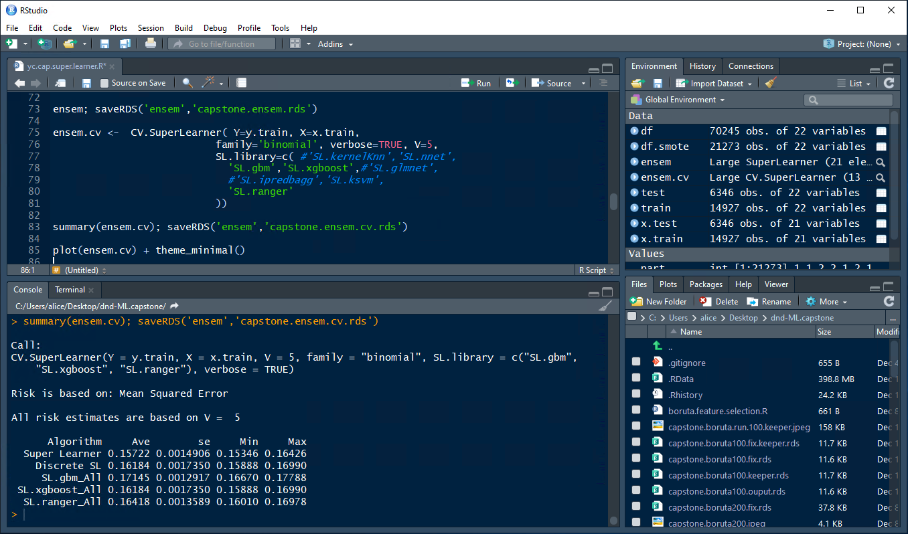
Notes:
> summary(ensem.cv); saveRDS('ensem','capstone.ensem.cv.rds')
Call:
CV.SuperLearner(Y = y.train, X = x.train, V = 5, family = "binomial", SL.library = c("SL.gbm",
"SL.xgboost", "SL.ranger"), verbose = TRUE)
Risk is based on: Mean Squared Error
All risk estimates are based on V = 5
Algorithm Ave se Min Max
Super Learner 0.15722 0.0014906 0.15346 0.16426
Discrete SL 0.16184 0.0017350 0.15888 0.16990
SL.gbm_All 0.17145 0.0012917 0.16670 0.17788
SL.xgboost_All 0.16184 0.0017350 0.15888 0.16990
SL.ranger_All 0.16418 0.0013589 0.16010 0.16978
>

Slide 35
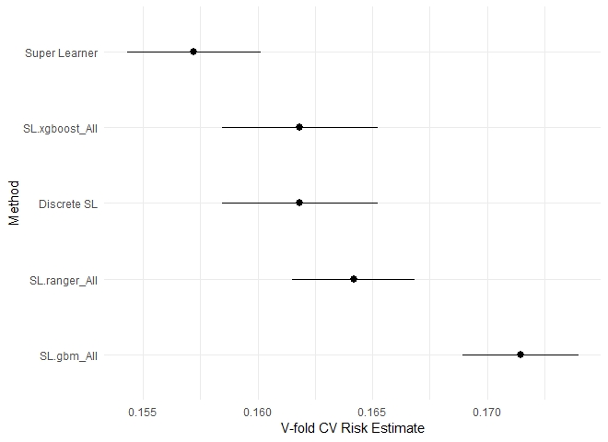

Slide 36
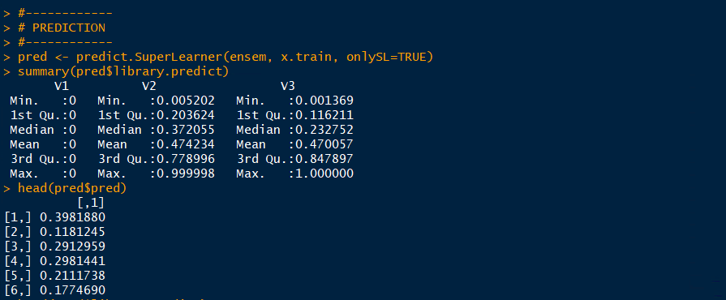
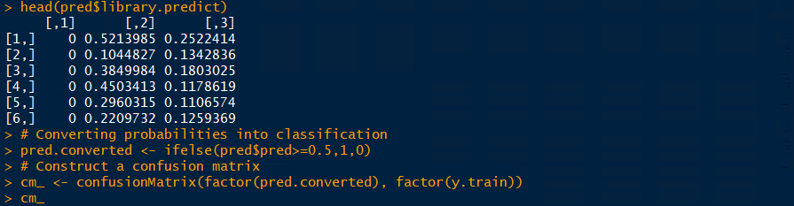

Slide 37
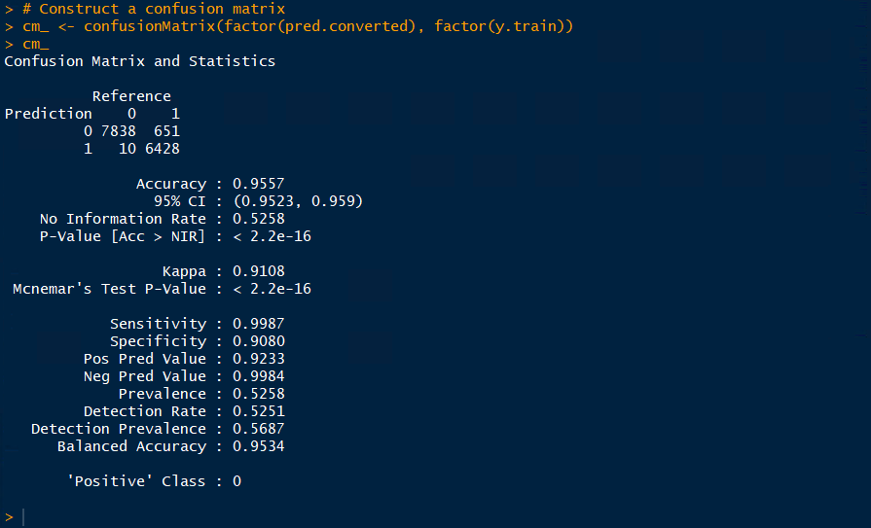

Slide 38
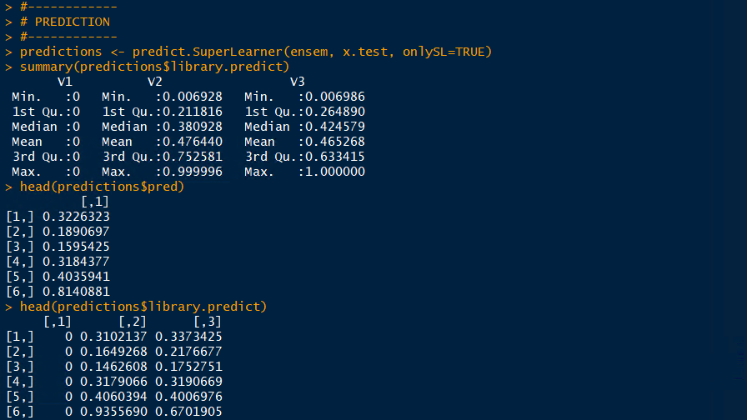

Slide 39
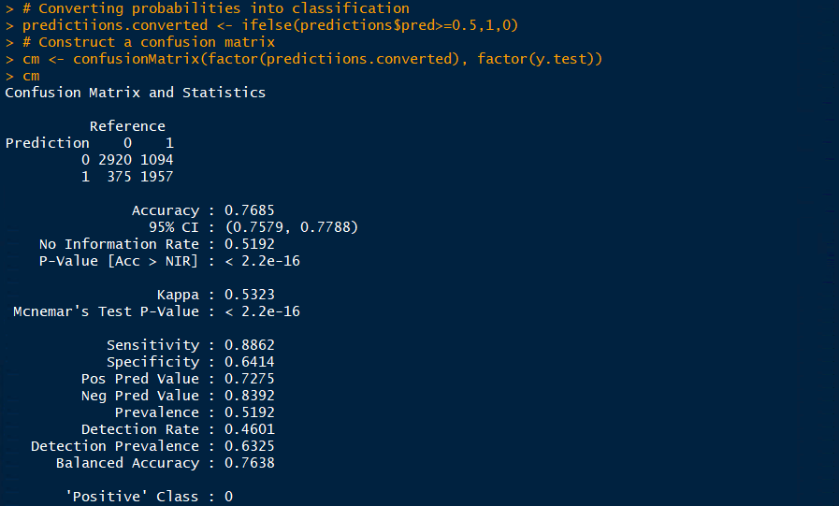

Slide 41



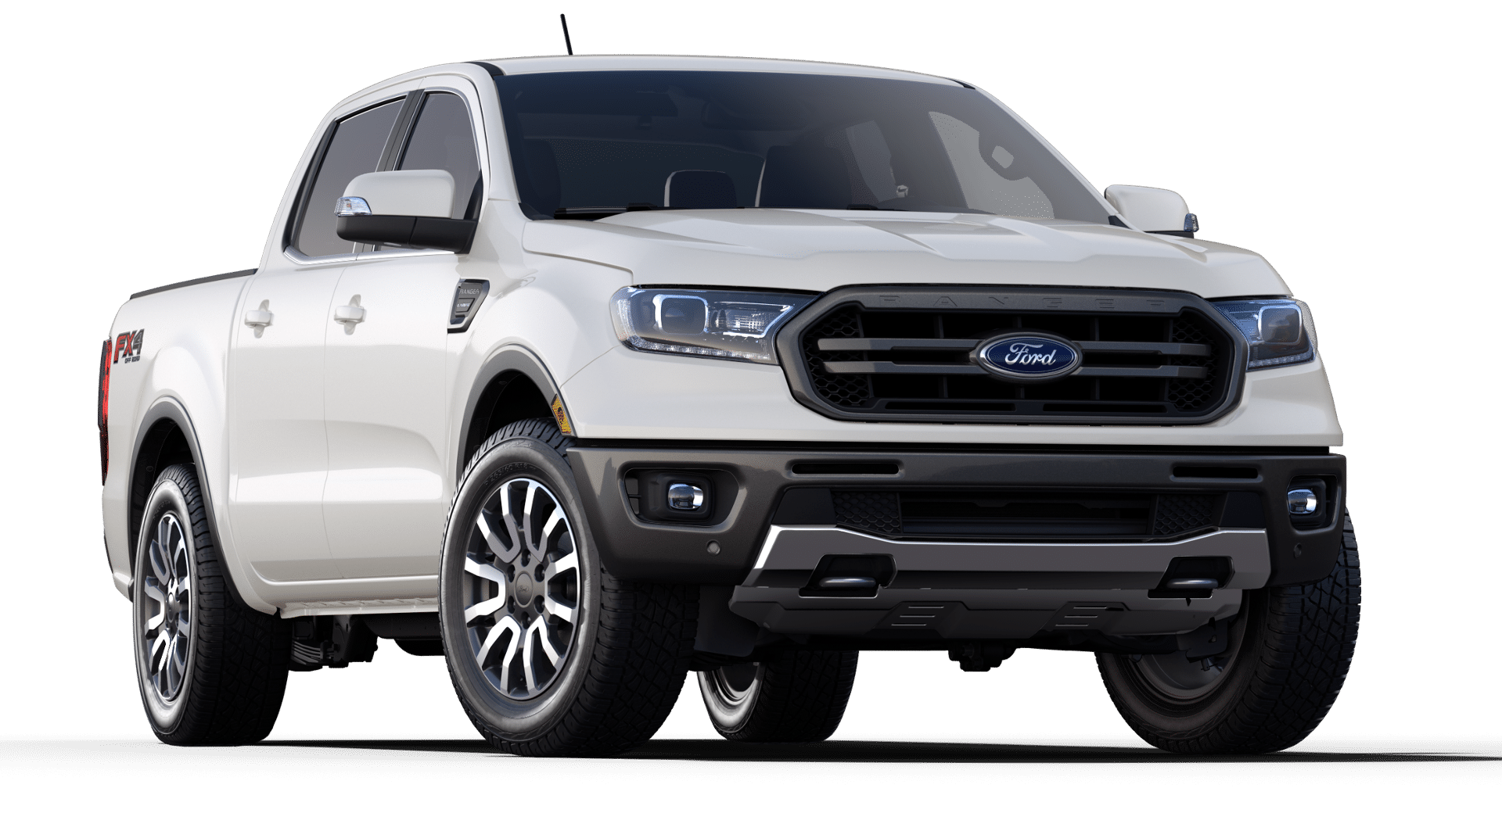
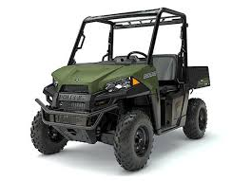

Slide 42
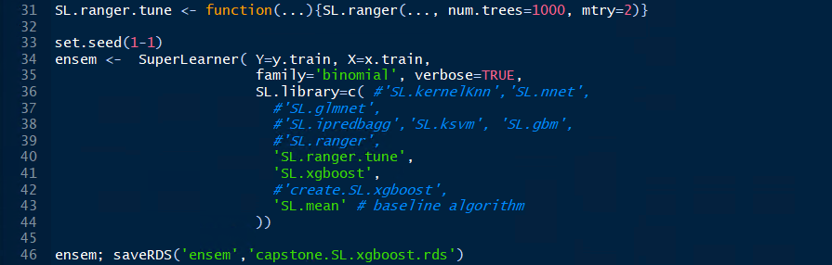
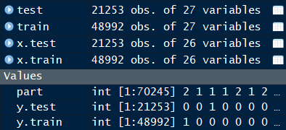

Tuning Ranger
Notes:
The training ran about 3 hours with the cloud vm,14 vcpus
not with smote data.

Slide 43


3rd run
num.trees = 1000
mtry = 5
V = 10

Slide 44

1st run
6K, 70/30
num.trees = 500
mtry = 5
V = 3

Slide 45

2nd run
6K, 70/30
num.trees = 1000
mtry = 5
V = 3

Slide 46


13K, 60/40 split
method = ‘ranger’
default settings
10-fold cv

Slide 47


54K, 60/40 split
method = ‘ranger’
default settings
10-fold cv
One… small step… for man…

Slide 48


$3.79 left

Slide 49


To SuperLearn, or Not to SuperLearn
Data issus when trying to predict
after a few hours of running

Slide 50

To SuperLearn, or Not to SuperLearn
It was unclear if the removal was for an iteration or the entire run.
Results of a 3-hour run

Slide 51


Lessons Learned
Predicting hospital readmissions with Machine Learning
A meaningful step to solve a complex problem
It does provide some insight of the service quality and a patient’s experience
Relevant to real world problem solving and warrant mode efforts
Data cleaning is tedious, yet at the end it pays off
SMOTE is so hot, it’s cool
Hello Ranger and good riddance RandomForest
Computing power was critical for productivity
I would like to underfit something at some point of time
Hyperparameters, there’s a reason why they are called ‘hyper’
Ensemble model = practices + practices + more practices
So many tools, so little time
Pick just a few and make some lemonade
Running code is a pass, interpretation the gig
I’M IN

Slide 52

Thank you
Honey, I’ll b home very soon.

Slide 53


Slide 54



Slide 55


Slide 56


Slide 57
1st run
num.trees = 500
mtry = 5
V = 3

Slide 58
2nd run
num.trees = 1000
mtry = 5
V = 3

Slide 59
3rd run
num.trees = 1000
mtry = 5
V = 10

Slide 60


Slide 61


Slide 62


Slide 63



Slide 64



